Slide 1

File formats for Fabric Lakehouse
John Miner Data Architect
john.miner@insight.com

Slide 2
Purpose
Microsoft Fabric went to General Availability in November of 2023. How can we leverage this new service to solve out business problems?
Right now, there are four types of problems that can be solved with Fabric: lake house, data warehouse, data science and real time analytics.
Today, we are going to explore how you can use fabric within your organization.

Slide 3
Microsoft Fabric - Topics
Overview of Spark Eco-system.
What is the medallion architecture?
Weak vs strong file formats.
Zipping to decrease file upload times.
Exploring spark file formats *
Working with RDBMS sources **
* - key learning objective
** - bonus round if time permits

Slide 4
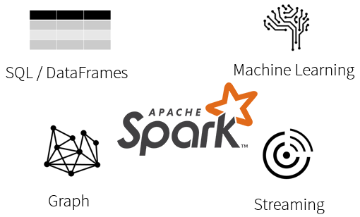
What is Spark?
Spark is a unified processing engine that can analyze big data using SQL, machine learning, graph processing or real-time stream analysis.

Slide 5
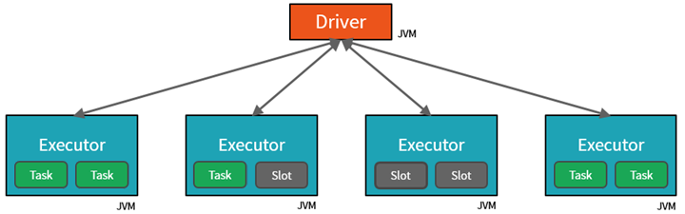
Spark Cluster
By creating Tasks, the Driver can assign units of work to Slots for parallel execution.
The Driver must also decide how to partition the data so that it can be distributed for parallel processing.
Fabric automatically has a starter cluster waiting for you to use!

Slide 6
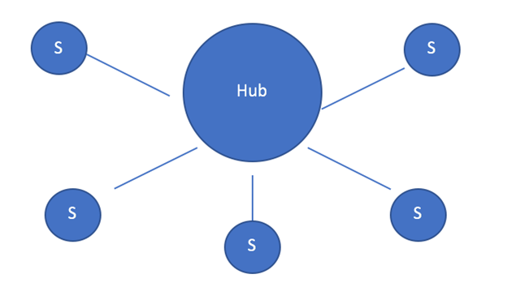
Data Hub (Hub & Spokes)
A loosely couple design pattern.
The producers write data to the hub.
The consumers read data from the hub.
Typical called an operational data store.
With big data, use of data lake storage.
Can be the single source of truth for a company.

Slide 7
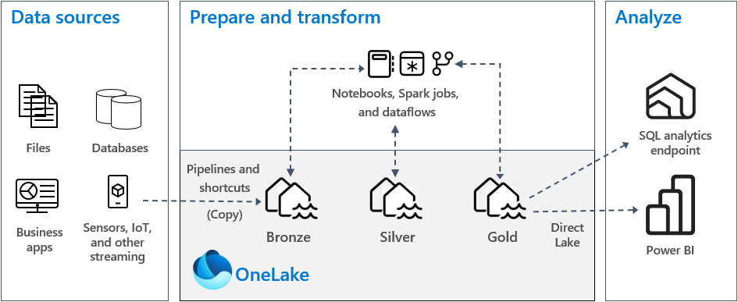
Medallion Architecture

Slide 8
Data Lake – Various File Types
Weakly typed file formats can lead to data quality and ETL pipeline issues. For instance, a delimited file type as Comma Separated Values (CSV) can be easily broken. This file type does not allow for compression.
Strongly typed file formats can lead to better data quality and the least amount of ETL pipeline issues. For instance, an Apache Parquet file format is stored as binary data, contains columns names/types and allows for compression of the data.

Slide 9
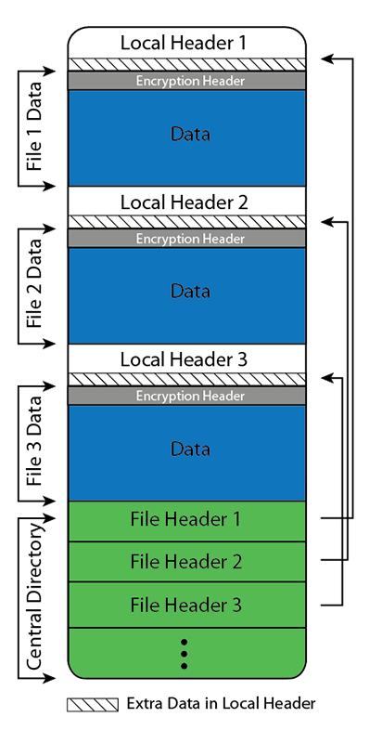
Zipping Files For Transport
The one lake storage is based upon Azure Data Lake Storage Gen2.
A no code solution is to zip up the files locally and manually upload the data using the lakehouse explorer.
Data pipelines can use a binary copy activity to move data into the cloud.

Slide 10
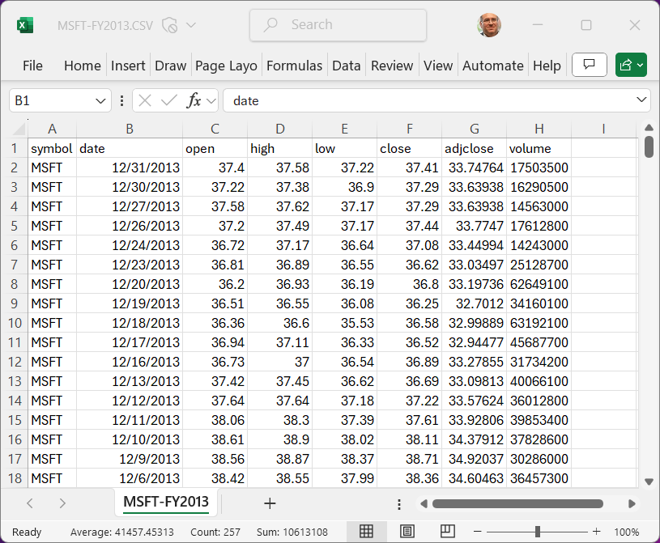
Delimited Files
Each row of data is ended by a carriage return and line feed in Windows.
The header for the file is optional. If not supplied, you should define using a custom schema.
Short cut notation can be used when writing spark SQL . If using the spark read() method, many options can be defined such as string quoting, choice of delimiter, and optional header.
Please note, only managed tables can be used in the SQL analytic endpoint and the semantic model.

Slide 11
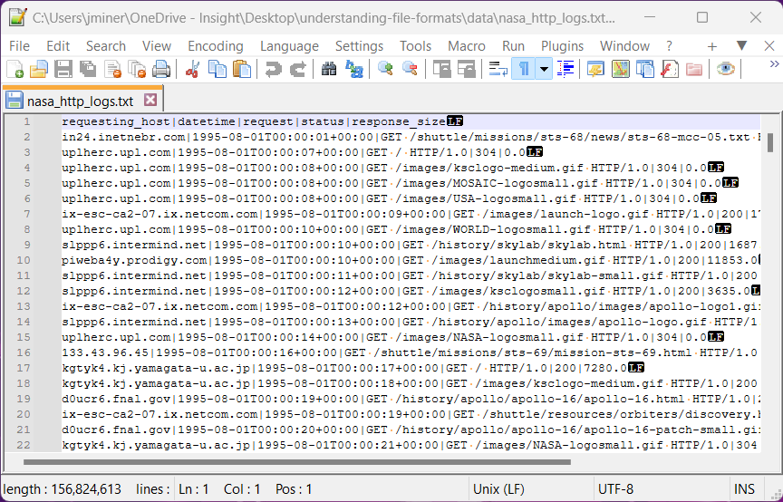
Text Files
Some files are created using unstructured or semi-structured data formats.
How can we extract the data from the file by parsing each row.
During parsing, unwanted rows are tossed. Rows with interesting data are saved for downstream consumption.

Slide 12
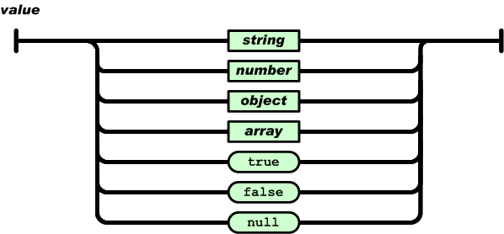
JSON Files
JSON (JavaScript Object Notation) is an open standard file format which uses human-readable text to store and transmit data objects consisting of name–value pairs.
If you work with REST API endpoints, the input and output information is usually stored as JSON.
Like all text formats, bloat may occur due to redundant column names.

Slide 13
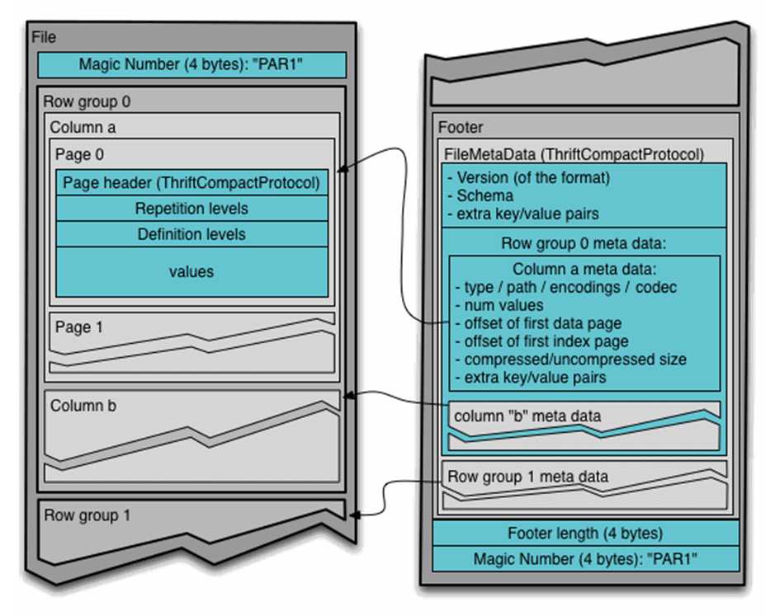
Apache Parquet Files
What is the Apache Parquet File format?
It is a binary format in which the meta data is separated from the data.
Instead of being in a row-based format like CSV, data is stored as column chunks by row. This format lends itself to partitioning as well as compression.

Slide 14
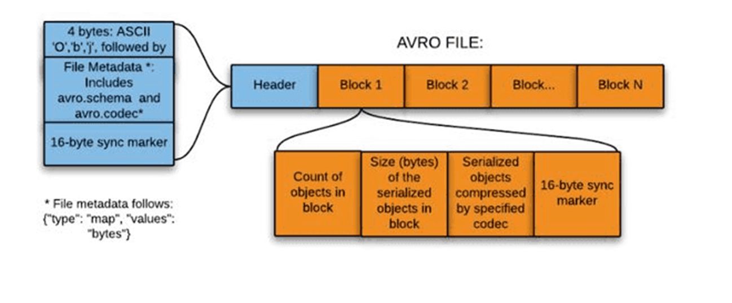
Apache Avro Files
Avro is one of the three formats that came from the Apache foundation.
The format was designed to de-serialize data for Remote Procedure Calls (RPC).
The metadata for the file is stored in a JSON format while the contents of the file are stored in row fashion.

Slide 15
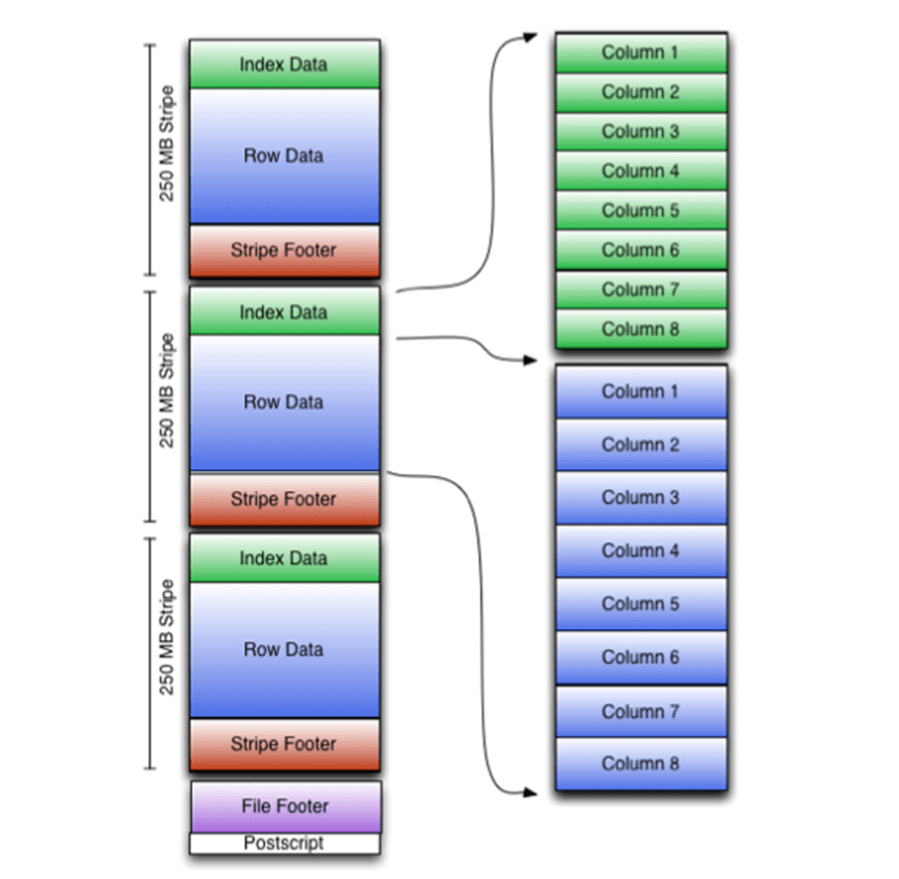
Apache Orc Files
The Apache Optimized Row Columnar (ORC) file format was designed to fix problems with Hadoop’s RC File format.
First, the format supports a variety of compression techniques on top of the column store format.
Second, predicate pushdowns can be used to read only columns that are required.
Third, light weight indexes keep track of min and max values.

Slide 16
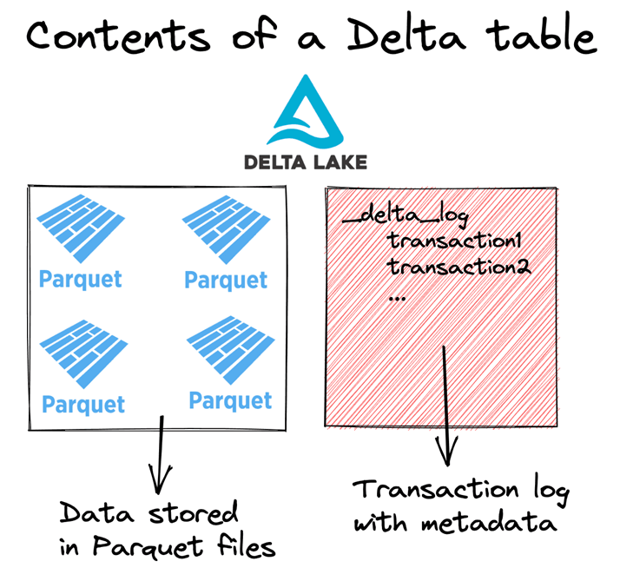
Delta File Format
ACID transactions make sure complete writes are committed.
Schema enforcement allows only clean data inserted into the lake.
Time travel allows for versioning the delta lake table. Thus, we can view data at any given point.
Snapshot isolation allows for multiple readers and writers.
Open-source format that is built for distributed systems such as Spark.

Slide 17


Relational Database Management Systems
Place secrets in key vault for safe keeping.
Create spark environment with driver for PostgreSQL.
Write functions to read a table and return a dataframe; and to save a dataframe to a new lakehouse table.
Use metadata to move pubs tables to lakehouse.

Slide 18
Summary
Microsoft Fabric is the one stop shop for all your data and analytical needs. As a developer, you can pick an architecture using a lake house, data warehouse, machine learning, or Kusto database to solve real world problems.
What I did not show is how to use co-pilot to help code these solutions. The only draw back I see right now is the fact that co-pilot requires an F64 SKU which is around 8K per month. This is a high entry point for small to medium size customers.
During my exploration of the services, I logged several bugs. The road map for Fabric includes adding more sources to the lake as well as expanding on real time ingestion.
If you have your skill set includes SQL, Python and Spark, you should be right at home with the new product offerings. The future is bright for those who can adapt.

Slide 19
References - Technology
Fabric – Lake House
https://tinyurl.com/4fdk4bux
Fabric - Notebooks
https://tinyurl.com/5bydabub
Files – Text Format
https://tinyurl.com/3tkkh2c3
Files – CSV format
https://tinyurl.com/3f27x2vm
Files – JSON format
https://tinyurl.com/n3h22fdh
Files – Avro Format
https://tinyurl.com/58wdz6mz
Files – Orc Format
https://tinyurl.com/c96bs8ye
Files – Parquet Format
https://tinyurl.com/mrxw32wx
Files – Delta Format
https://delta.io/
JDBC – PostgreSQL Connector
https://tinyurl.com/5n76tyjz

Slide 20
References – Data Sets
Stock Data
https://tinyurl.com/44hhzz2j
Nasa Data
https://tinyurl.com/4f8jr38x
Earthquake Data
https://tinyurl.com/4p4zh3m8
Iris Data
https://tinyurl.com/5n8fj3f8
Pubs Database
https://tinyurl.com/bdfhhx4e

Slide 21
Questions / Thank You

